Slide 1

FYP REPORT
Team
Haseeb Ur Rehman 19F-0951
Ameer Hamza 19F-0972
Riyan Athar 19F-1009
Supervisor Sajid Anwer
CO-Supervisor : Tahir Farooq

Slide 2

LOGO

Slide 3
Team/Company Name:
Fantastic Three
Project Name/Title:
FetchBusiness.com

Slide 4
Outline
Project Introduction
Modules detail
UML Diagrams
Deliverables
References

Slide 5
Project Introduction
People want second source of income.
The project enables people in finding a right business/startup to invest in. The platform will list all the startups/businesses with different categories which require funds and a business partner.
The investor will select the business according to the rating provided by our worth calculation feature and ratings and can take a informed decision.
Traditional investment options like property and gold and which do not necessarily provide good returns.
Finding businesses is also a hectic task and requires lots of effort.

Slide 6
Modules
The project has four main modules
Admin Side
Manages posts and answers requests.
Manages user accounts.
Investor Module
Views different posts and selects the relevant posts.
The investor module will allow investors to browse through different startups in various categories. The categories of businesses will be based on the industry types and funding range.

Slide 7
Modules
Business Owner Module
Uploads all the necessary information and pictures about the business.
Posts can be edited and boosted in exchange of fee.
Experts Module
Experts will respond to the queries of startups
will guide the new businesses in market insights and legal help.

Slide 8
System Features
3.1. Online Posts
3.2. Expert Advice
3.3. Business Inspection
3.4. Chat
3.5. Verification
3.6. Milestone Track
3.7. Resource Finder
3.8. Business Worth Calculation:
3.9. Bidding
3.10. Recommendations

Slide 9
Functional Requirements
No | Requirements
FR-1 | System will allow business owner to upload post for his/her business and pictures of the business setup. The post will contain photos of the business setup including relevant details.
FR-2 | System will provide market insights and expert advice to business owner. Experts will respond to queries of business owner.
FR-3 | The system shall have chat feature available for investor and business owner for discussion. Email and phone number of the business owner will also be listed along the post.

Slide 10
Functional Requirements
FR-4 | The system shall have inspection rating which will be placed along the business owner’s post on the website. T inspection report will contain information about the organizational insights and capability.
FR-5 | The system will provide milestones tracking of business. The targets and goals will be shared with investor. The companies will update the investors about the current situation of the organization.
FR-6 | The system will have bidding which would consist of equity ratio to investment fund. Business owner can view all the offers from different investors and can select any of them.

Slide 11
Functional Requirements
FR-7 | The system will have questionnaire which will be asked from the business owner and on the basis of it the value/worth of the business will be calculated. Equity to Fund ratio will be automatically suggested by the platform to the business owner according to the worth of business.
FR-8 | The system will have business rating on the basis of worth calculation and inspection and recommendations will be given to the investors. Recommendations will require business owner to upload the documents like CMMI certificate, FBR documents for verification.
FR-9 | System will verify documents uploaded by the business owner. Admin will approve the request of post after confirmation of verification. Admin will approve the request of post after confirmation of verification. User will be authorized with two-way verification process through email.

Slide 12
Quality Requirements
No | Requirement
QR-1 (Usability) | The interface of the application should be simple and easy to use.
QR-2 (Security) | The system will be secure and data encryption of user data will be done.
QR-3 (Maintainability) | The system will be maintainable

Slide 13
Constraints
No | Constraint
CR-1 | System will need internet connection for connectivity.
CR-2 | The system will be web based application.
CR-3 | The system will only target software / tech companies.

Slide 14
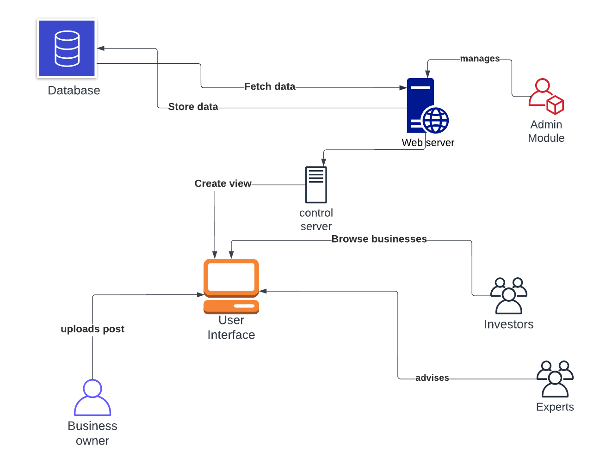
High Level System Diagram

Slide 15
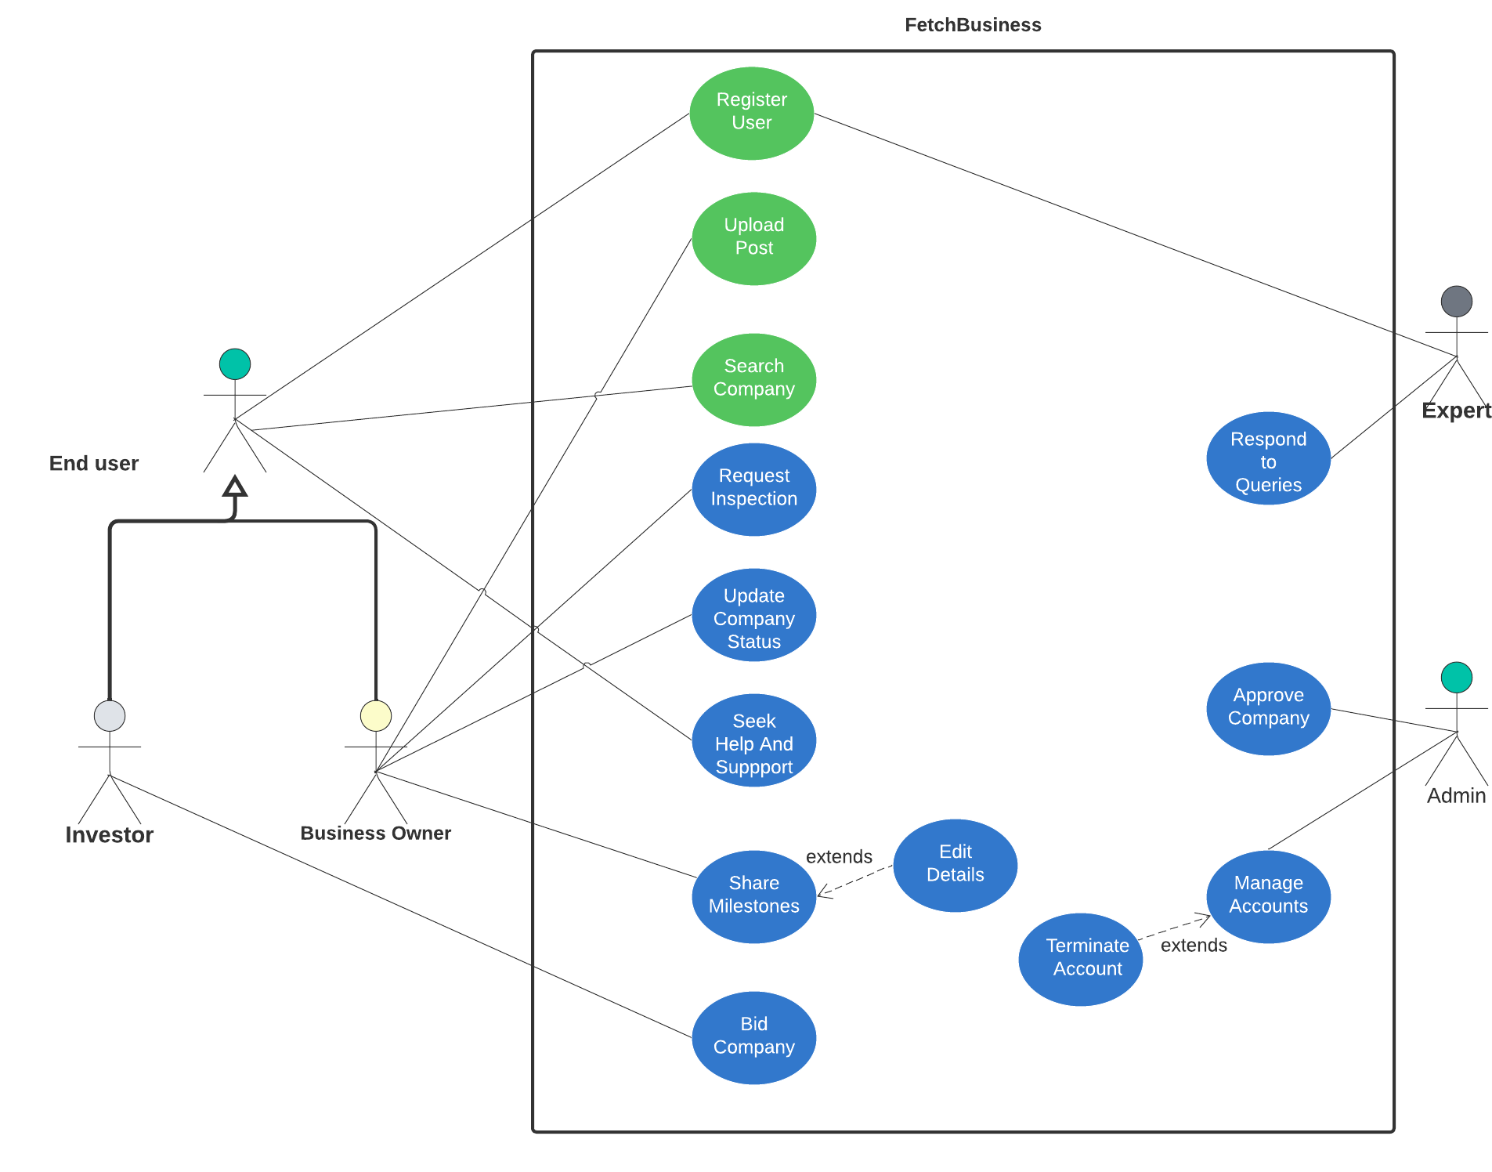
Use Case Diagram

Slide 16
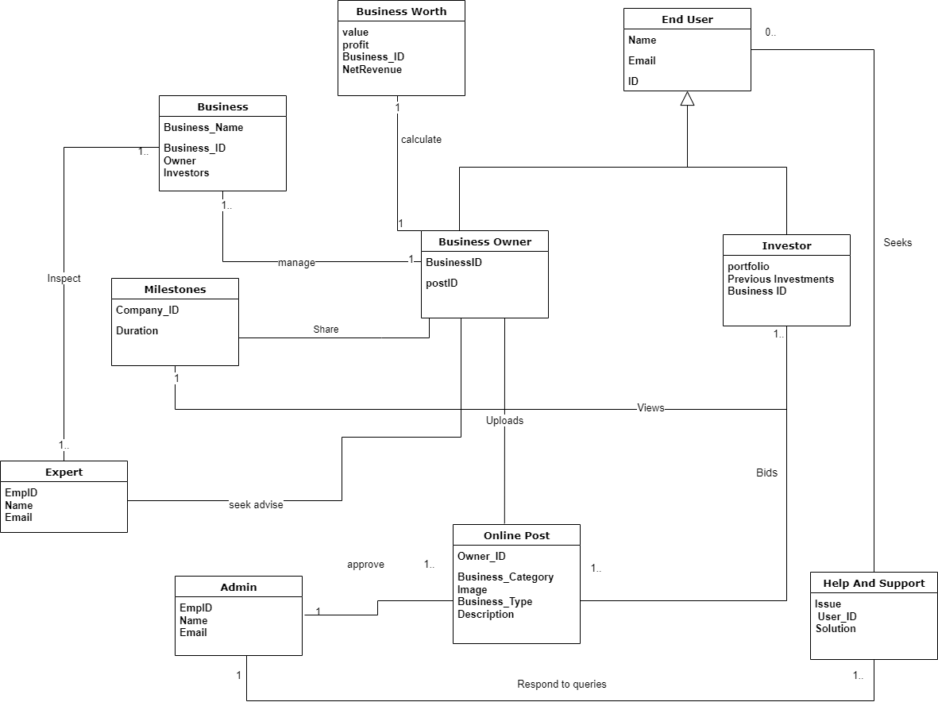
Domain Model

Slide 17
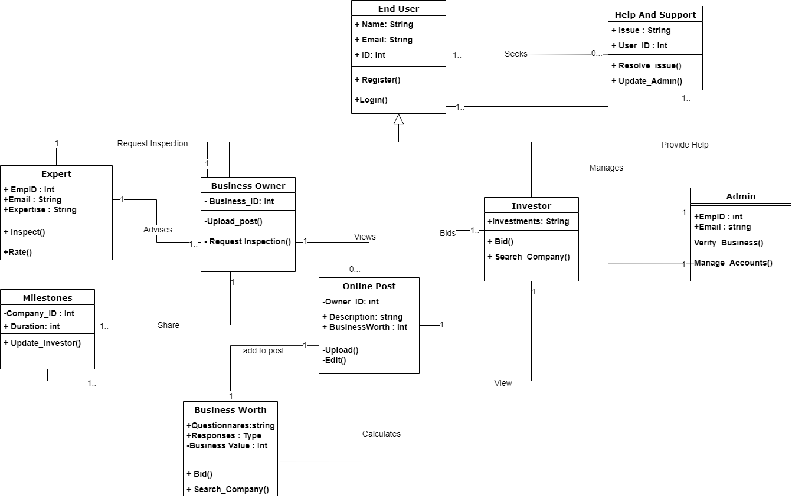
Class Diagram

Slide 18
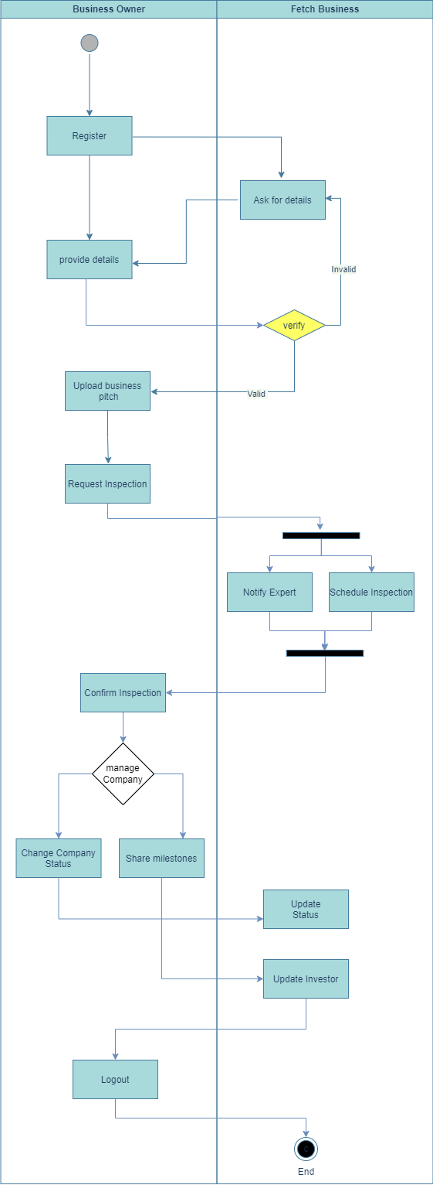
Activity Diagram

Slide 19
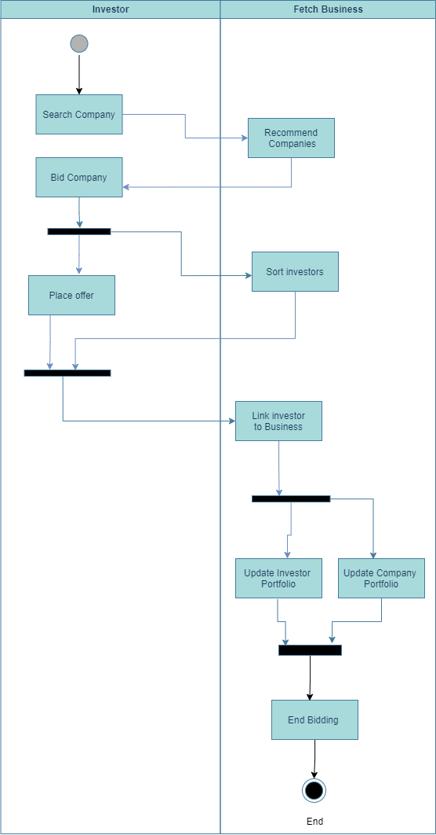
Activity Diagram

Slide 20
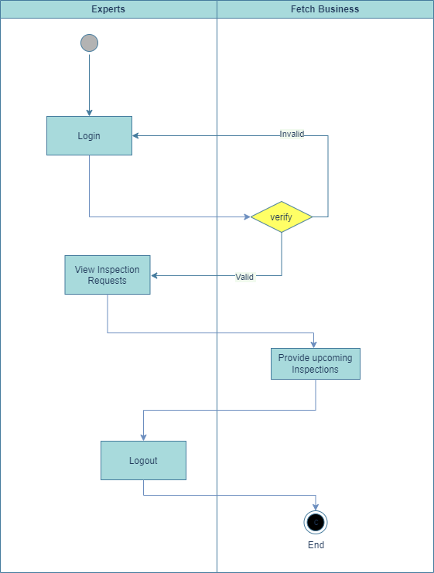
Activity Diagram

Slide 21

Activity Diagram

Slide 22
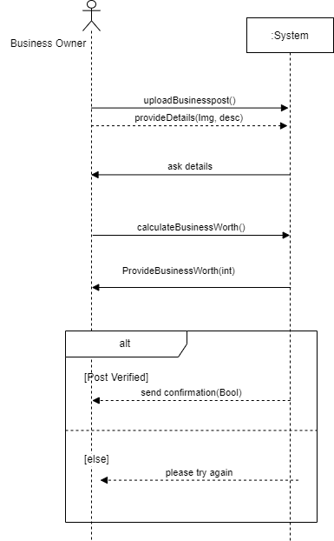
System Sequence Diagrams

Slide 23
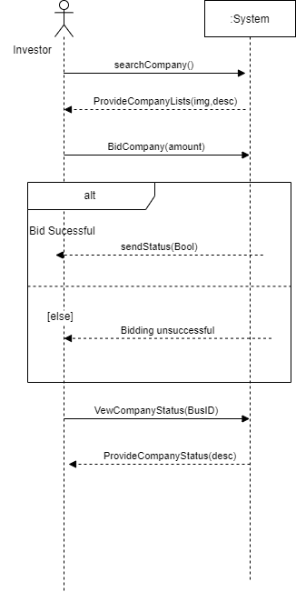
System Sequence Diagrams

Slide 24
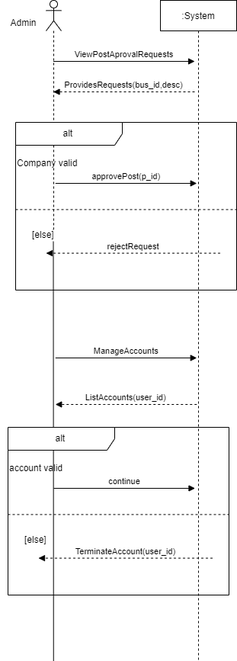
System Sequence Diagrams

Slide 25
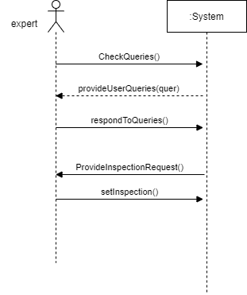
System Sequence Diagrams

Slide 26
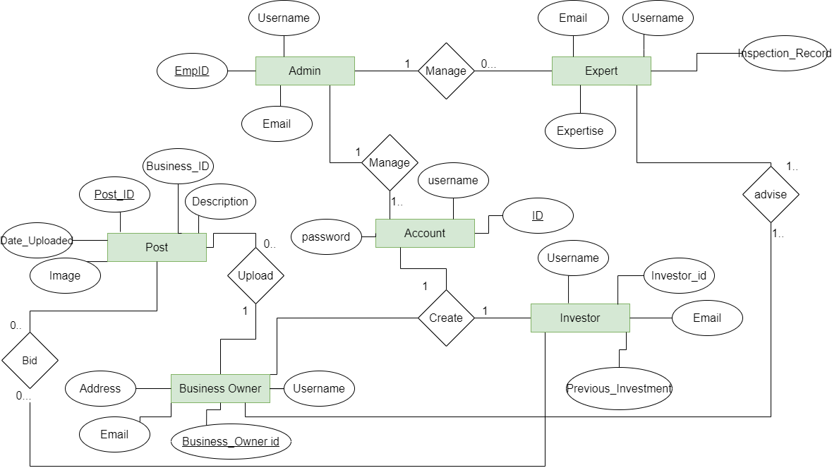
ERD Diagram

Slide 27
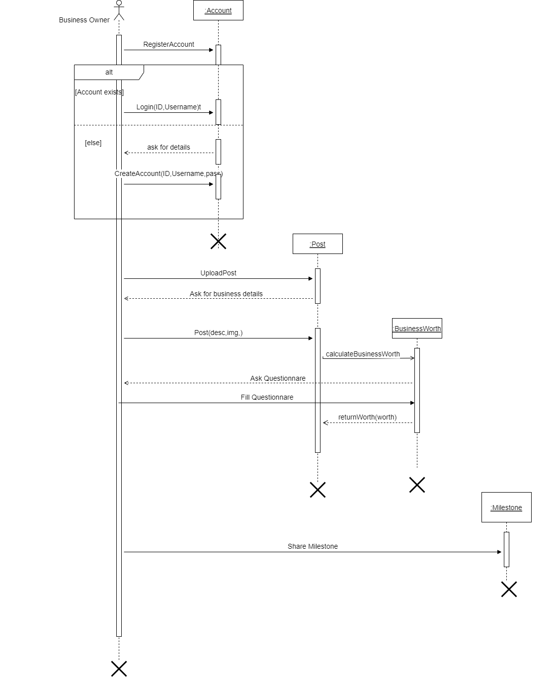
Sequence Diagram

Slide 28
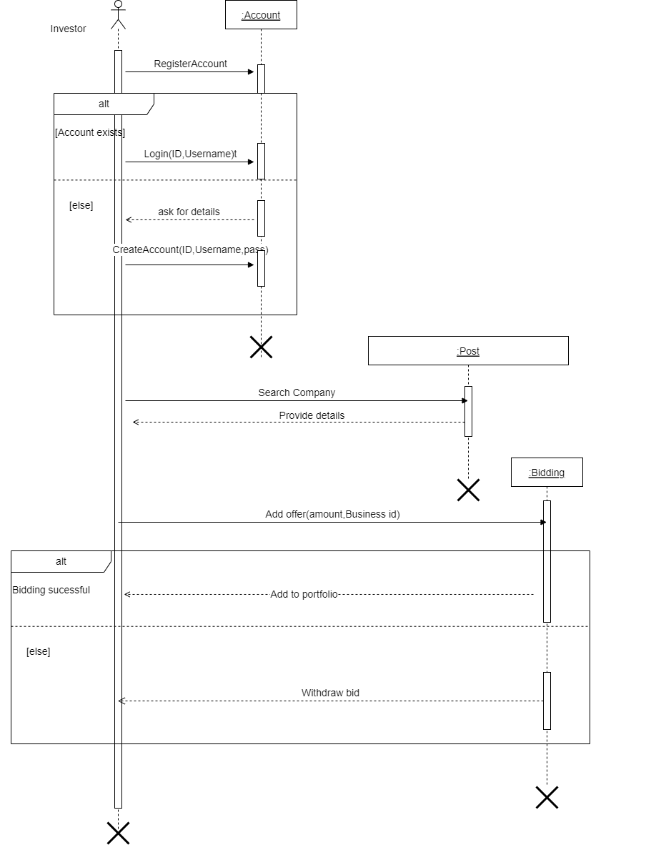
Sequence Diagram

Slide 29
30 % DELIVERABLES
Use case 1 | Register/login
Use case 2 | Business Owner(Upload Post) Without worth calculation
Use case 3 | Admin(Manage Account)

Slide 30
Tools/Technologies/Environment
UI/UX | Figma
Front End | React
Server side | Node JS & Express
Database | SQL Workbench

Slide 31
References
Applying UML and Patterns: An Introduction to Object-Oriented Analysis and Design and Iterative Development, Third Edition by Craig Larman
https://www.investopedia.com/articles/basics/12/challenges-investing-modern-world.asp (pg4)
https://www.business-standard.com/article/economy-policy/how-investors-are-moving-from-traditional-investments-to-new-alternatives-117071500209_1.html .(pg4)

Slide 32
Thank You!

